Slide 1
ASSIGNMENT-2
Kaveri M
950819106027
GCE-TIRUNELVELI

Slide 2
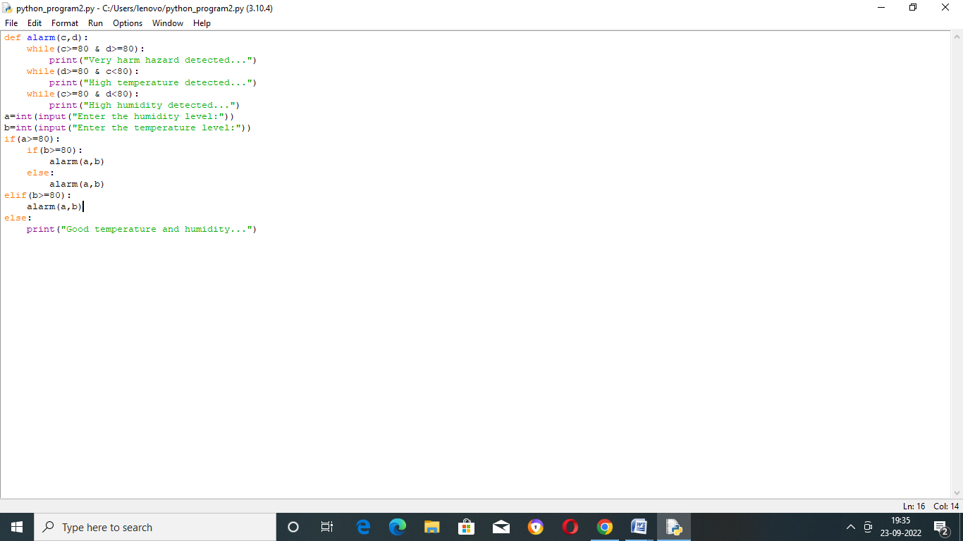

Slide 3
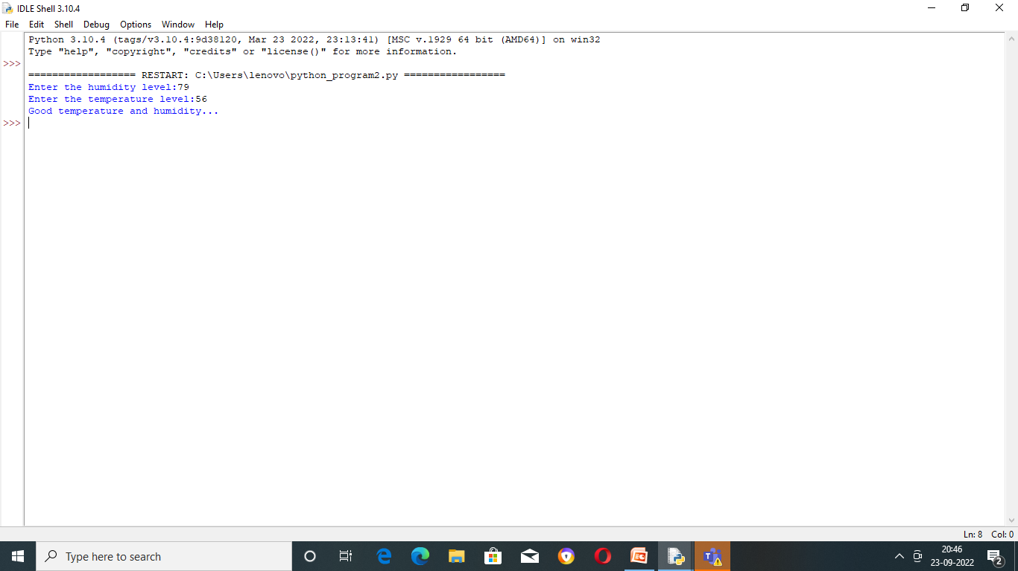

Slide 4
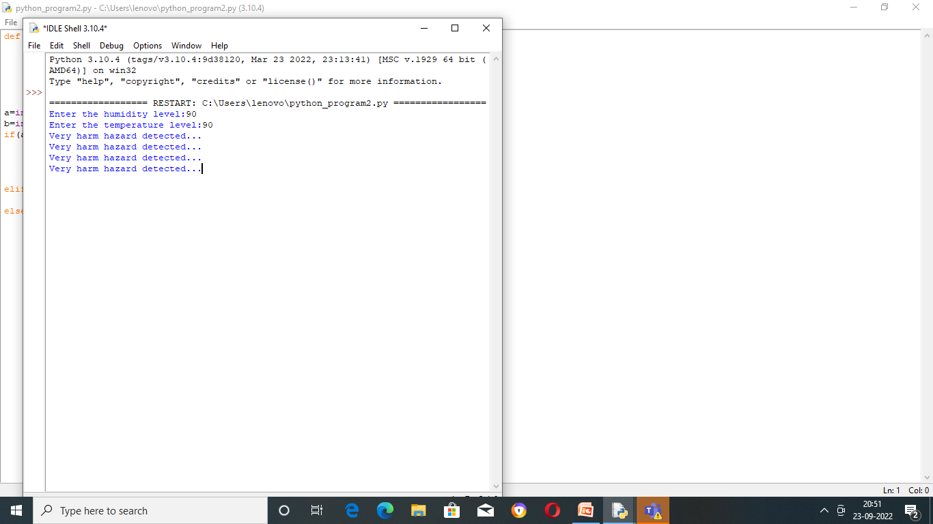

Slide 5
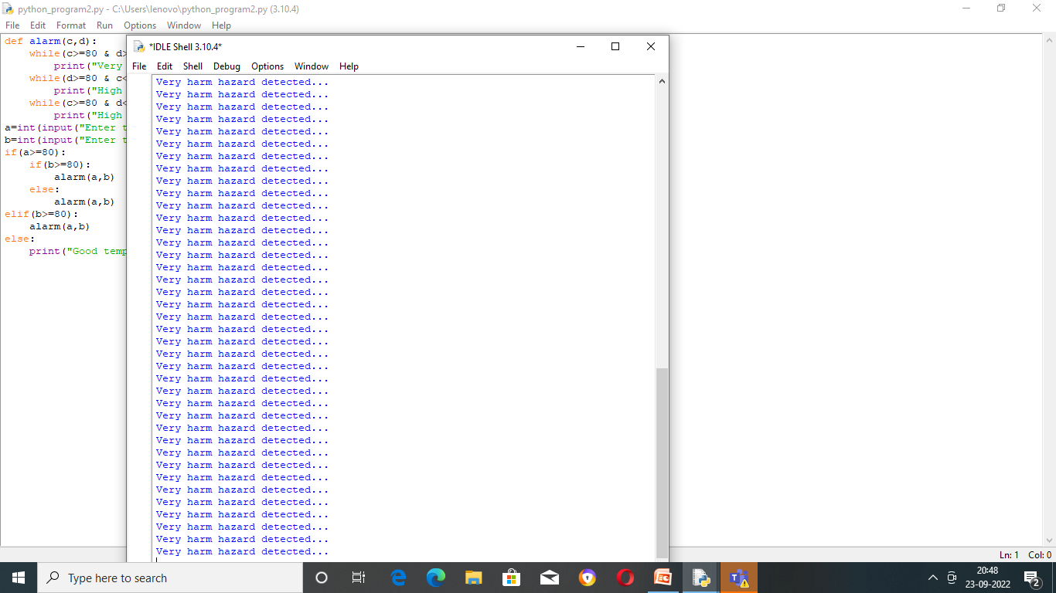

Slide 6
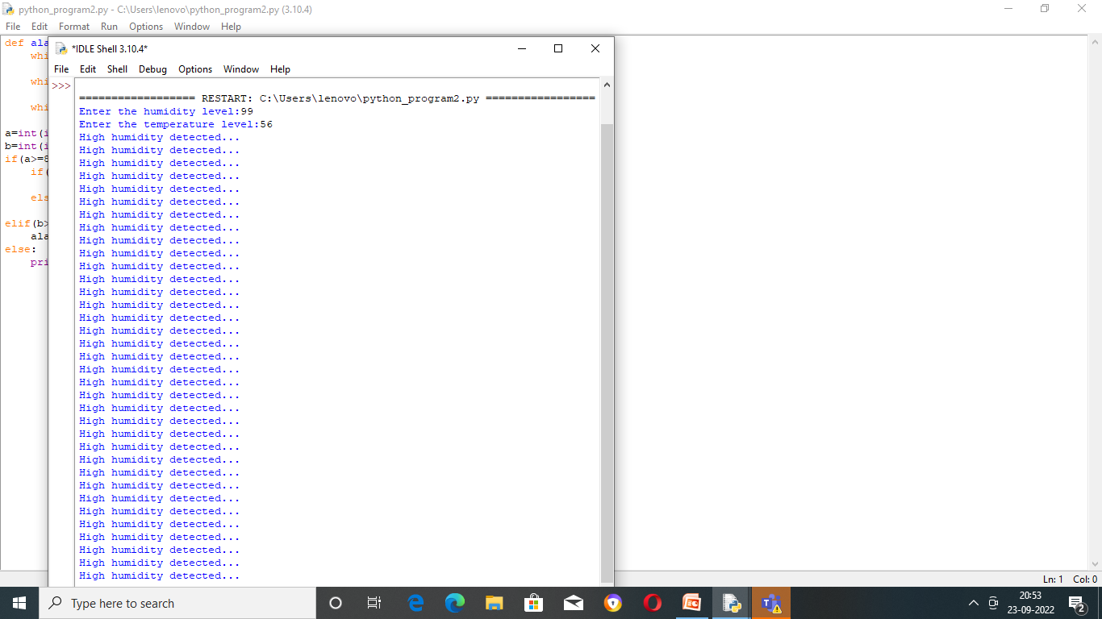

Slide 7
